Slide 1

Data Splitting and Bias-Variance Tradeoff
Diptangshu Banik
Twitter - @dipbanik

Slide 2
Overview
Data needs to be split into train set and test set so that we can validate our results from the model we build.
Usual split proportion varies from 3:2 to 4:1 depending upon how much data you have.
Important that your test results and train results are similar so that your model performs well in real world.

Slide 3
Code
>>> from sklearn.model_selection import train_test_split
>>> X_train, X_test, Y_train, Y_test = train_test_split(X, y, test_size = 0.2, random_state = 103)

Slide 4
Bias
Bias is the difference between the average prediction of our model and the correct value which we are trying to predict.
Model with high bias pays very little attention to the training data and oversimplifies the model. It always leads to high error on training and test data.

Slide 5
Variance
Variance is the variability of model prediction for a given data point or a value which tells us spread of our data.
Model with high variance pays a lot of attention to training data and does not generalize on the data which it hasn’t seen before.
High Variance models perform very well on training data but has high error rates on test data.

Slide 6
Mathematically
Y=f(X) + e
Where e is the error term

Slide 7
Noise
Noise is unwanted data items, features or records which don’t help in explaining the feature itself, or the relationship between feature & target.
Noise often causes the algorithms to miss out patterns in the data.
Examples –
Mistyped information
Meaningless features

Slide 8
UnderFitting
Underfitting happens when a model is unable to capture the underlying pattern of the data. These models usually have high bias and low variance.
Reasons –
we have very less amount of data to build an accurate model
when we try to build a linear model with a nonlinear data.

Slide 9
OverFitting
Overfitting happens when our model captures the noise along with the underlying pattern in data. These models have low bias and high variance.
Reasons –
we train our model a lot over noisy dataset
when we try to build a linear model with a nonlinear data.
These models are very complex like Decision trees which are prone to overfitting.

Slide 10
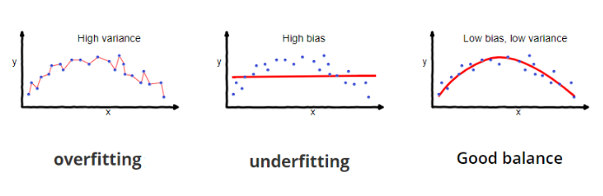
Graphically

Slide 11
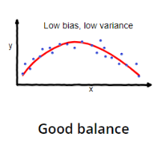
Bias-Variance Tradeoff
To build a good model, we need to find a good balance between bias and variance such that it minimizes the total error.
An optimal balance of bias and variance would never overfit or underfit the model.

